Slide 1
Tri County
Care Management Organization
PerformCare: 877-652-7624
http://www.performcarenj.org/families/index.aspx
Presented by:
Reginald Rosarion, MA
Director of Training
rrosarion@tricountycmo.org

Slide 2
Who We Are:
Tri County CMO, a non-profit care management organization for youth aged 5-21 in Warren, Hunterdon, and Somerset counties, is part of the Children’s System of Care within the NJ Dept. of Children and Families.
We strive to ensure that all youth with complex behavioral, developmental or addiction challenges have access to tailored, comprehensive formal and informal resources.
What We Do:
Provide intensive care management services from date of enrollment through well-developed transition plans;
Build wraparound strength-based individualized service plans that are child-centered, family driven;
Enhancing family voice, choice and independence;
Ensure that services are community-based, culturally-competent, responsibly authorized, delivered and monitored, with documented outcomes and without waiting lists or eligibility barriers;
Strive to keep youth at home, in school, and in their communities via Child/Family Team and community partner collaboration.
Where We Are:
Employing our wraparound care model, we serve youth and families
in their homes & communities.
We collaborate with our system partners, our schools and our
community-based providers in enjoining our services and strengths in
keeping families strong.

Slide 3
Each youth has an Individual Service Plan (ISP):
comprised of the family vision, needs, strategies and identification/linkage of formal and informal services and supports.
ISPs contain services to support:
Mental Health/Emotional/Behavioral Challenges
Intensive-in-Community (IIC), Behavioral Assistance (BA), intensive outpatient services, mentoring, psychological and/or psychiatric evaluations, and out of home treatment (when in-home and in-community do not meet youth’s level of need).
Substance Use Challenges
IIC staff with Licensed Clinical Alcohol and Drug Counselor (LCADC) credential, substance abuse evaluations and treatment.
Developmental or Intellectual Disabilities Challenges
Supporting DD application process, Family Support Services (FSS); Respite and Camp options, Intensive-in-Home therapeutic & clinical services.

Slide 4
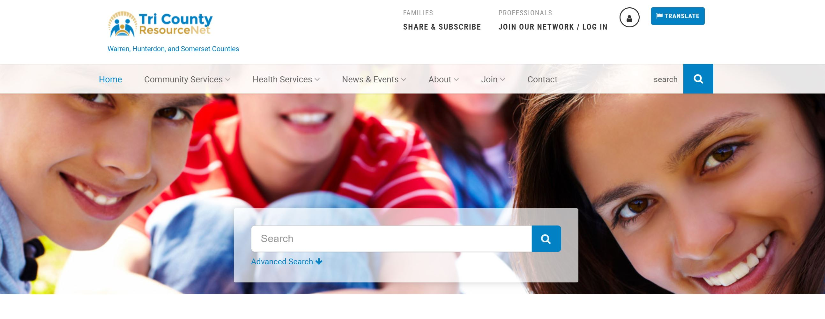
Our services can also INCLUDE:
Bilingual support in care management, as well as connection to bilingual community providers and resources. (There are no barriers when it comes to serving undocumented youth and families.)
Connection to diverse array of programs and activities via the Family Success Centers.
Support of a Family Support Partner as well as youth participation in the Youth Partnership via the Family Support Organization. https://www.tricountyresourcenet.org/search/family-support-organization-fso-hunterdon-somerset-warren/
Linkages to basic needs resources and supports. Visit www.tricountyresourcenet.org

Slide 5
How to Access Tri County CMO Services
Contact 1-877-652-7624 http://www.performcarenj.org/families/index.aspx (video guide)
School/community members may call with parent/legal guardian available to give consent.
Youth must meet care management organization level of care.
Contact Us
Phone: (908) 526-3900
Contact our Info Line (Option 8)
Email: info@tricountycmo.org
Website: www.tricountycmo.org
For resources and supportive services in Hunterdon, Somerset and Warren counties visit: www.tricountyresourcenet.org
Interested in Receiving a Nurtured Heart Approach® Training or for information on the DREAMS Initiative Contact Nicole del Duca, MA LAC (908) 526-3900 x140 or
ndelduca@tricountycmo.org

Slide 6
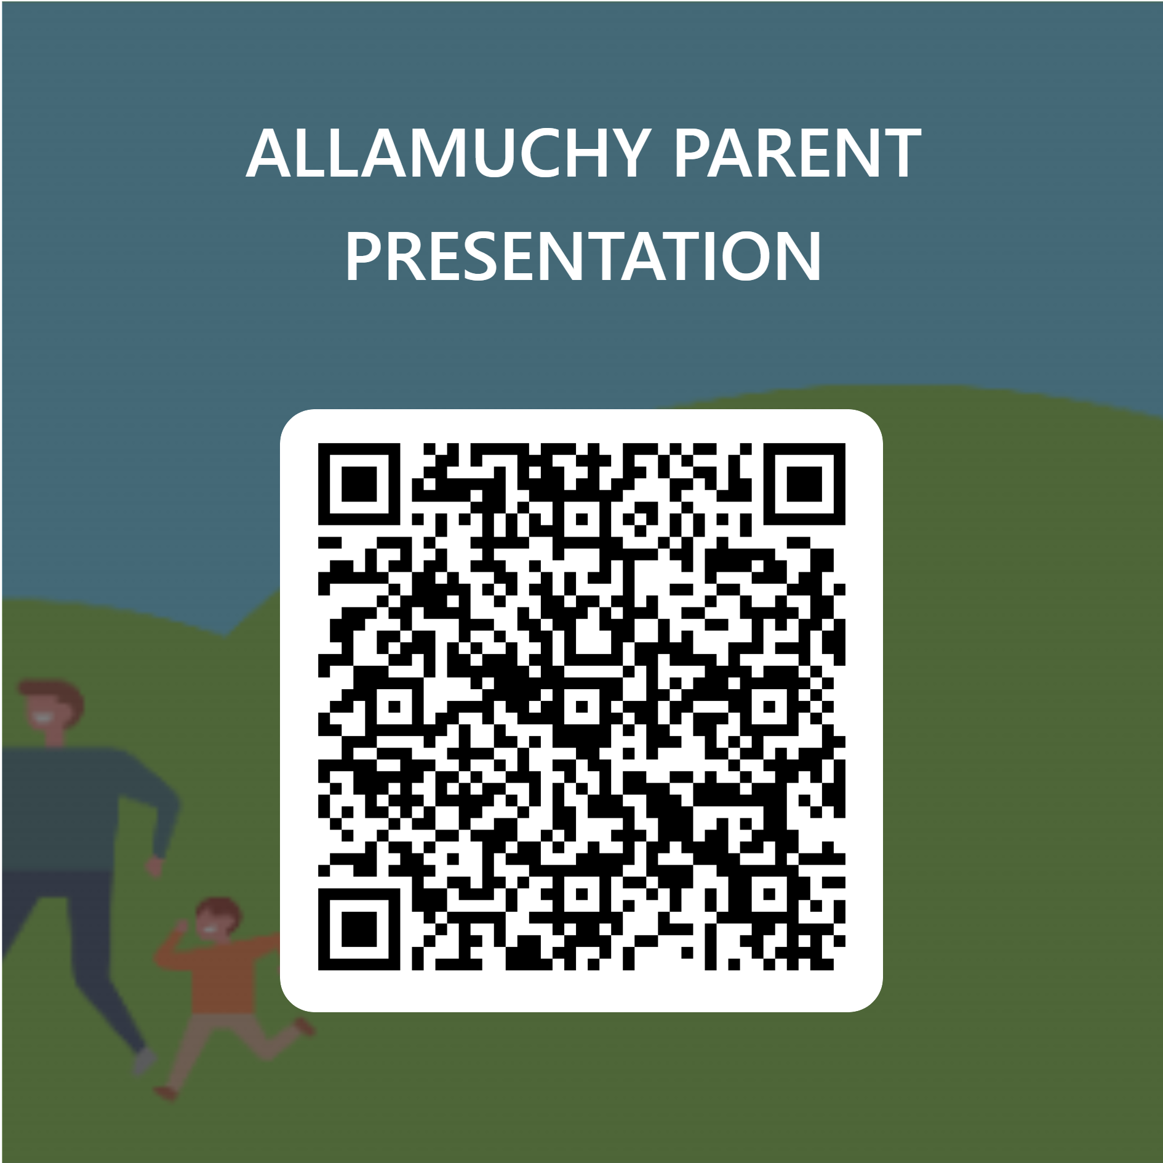
THANK YOU!
PLEASE SHARE SOME FEEDBACK

